Slide 1
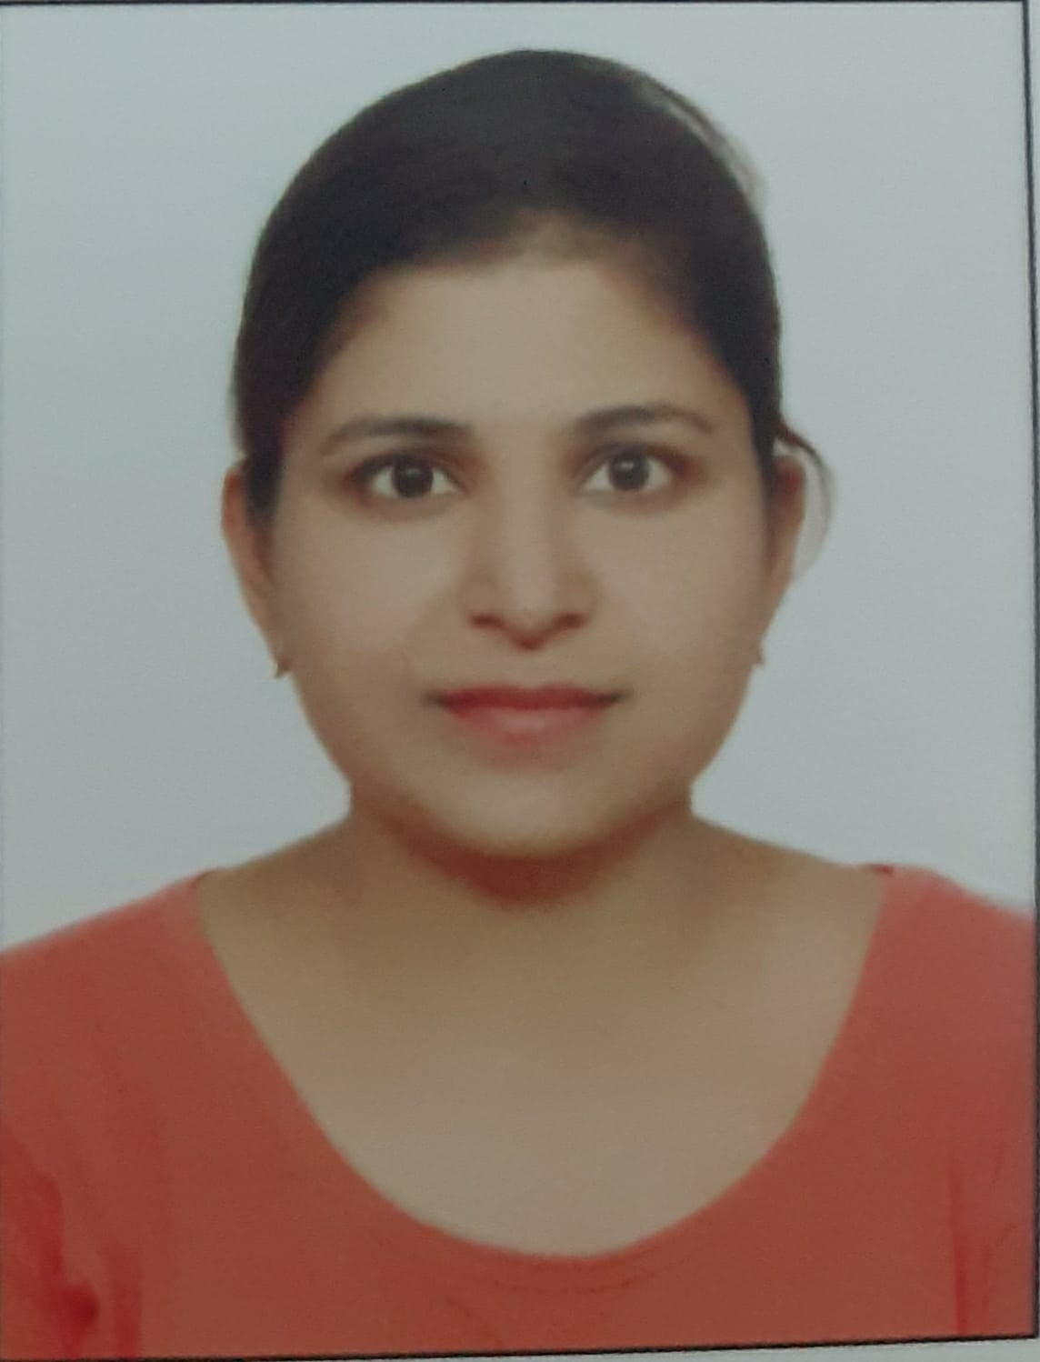
Team CVs
Project Oversight
OVERVIEW
Vibha Garg is an experienced AI and analytics leader with over 12+ years of experience across consulting, AI transformation, and product management. She has led large-scale AI strategy and implementation programs, working closely with senior government stakeholders and CXOs to drive data-driven decision-making, operational efficiency, and cost optimization. Her experience spans AI strategy, enterprise AI platforms, and end-to-end implementation, with a strong focus on public sector transformation and large-scale digital initiatives
KEY PROJECTS
Gen AI based earnings narrative asset - Led the design and deployment of a Generative AI powered solution that automatically generates earnings narratives for global CEO from earnings calls and transcripts
Led development of Store clustering and outlier analysis dashboard to monitor stores with high inventory and cash variance driving process related enhancements and actionable insights. Also led development of P2P solution with actionable insights and simulation capability to calculate impact of various P2P strategies and improve vendor payment experience.
Led development of risk profiling solution to categorize brokers in high/medium/low risk categories and analyze its cash flow impact for a UK based insurance client.
Led the cross-functional team to successful implementation of Global intelligent platform which serves as one stop solution with 360-degree view on financial landscape with 100+ KPIs.
AI Strategy & Platform Design for Road & Transport Authority, Dubai - Designed and developed the business case, product requirements, architecture, RFI and RFP for an Enterprise AI Platform. Conducted gap analysis for Cloudera Big Data Platform with respect to its usage for Artificial Intelligence. Assessed 135 AI projects and ideas and prioritized them based on their business impact and complexity. Prepared AI Strategic plan and AI implementation roadmap of these projects. Conducted data and systems AI readiness of 100+ RTA systems including assessment for Big Data Platform and DW
AI Strategy & Transformation - Led AI strategy and acceleration roadmap for Government of Andhra Pradesh Assessed 130+ AI use cases across scalability, feasibility, and data readiness Defined procurement pathways and implementation roadmap Led AI market activation initiatives. Designed Solution Architecture for the AI Solutions in different domains.
Gen AI Solutions - Led development of GenAI solutions with role-based access leveraging structured and unstructured datasets to obtain information regarding procurement from both structured and un-structured datasets with enablement of role-based access.
Led the design and development of a B2B financial management product - a fund disbursement solution to manage hierarchical payments with multiple approval levels expenditure head wise and to monitor the funds.
Vibha Garg
Engagement Manager
EDUCATION & QUALIFICATIONS
MBA (Finance and AI/Analytics), Institute of Management (IIM), Kashipur
B.Tech (E.C)
FUNCTIONAL EXPERTISE
AI strategy formulation and roadmap design, Government consulting and public sector transformation. AI use case identification, prioritization, and business case development. Stakeholder management and CXO-level advisory. Product management and digital solution design. Program and delivery management for large-scale AI initiatives.
LANGUAGES
English | Hindi
© 2026 Deloitte Touche Tohmatsu India LLP
Confidential

